Slide 1
Data Screening
Psy 524
Dr. Andrew Ainsworth

Slide 2
Data check entry
One of the first steps to proper data screening is to ensure the data is correct
Check out each person’s entry individually
Makes sense if small data set or proper data checking procedure
Can be too costly so…
range of data should be checked

Slide 3
Assumption Checking
Whenever you assume you make an…

Slide 4
Normality
GLM – Assumes a normally distributed sampling distribution
Typically met with either large N OR by assuming the population is normally distributed
When N is smaller the scores are often checked for normality
Violations – skewness, kurtosis and outliers

Slide 5
Normality
Skewness statistic - output by SPSS and SE skewness is

Slide 6
Normality
Kurtosis (univariate) – is how peaked the data is; Kurtosis stat output by SPSS
Kurtosis standard error =
for most statistics the skewness assumption is more important that the kurtosis assumption

Slide 7
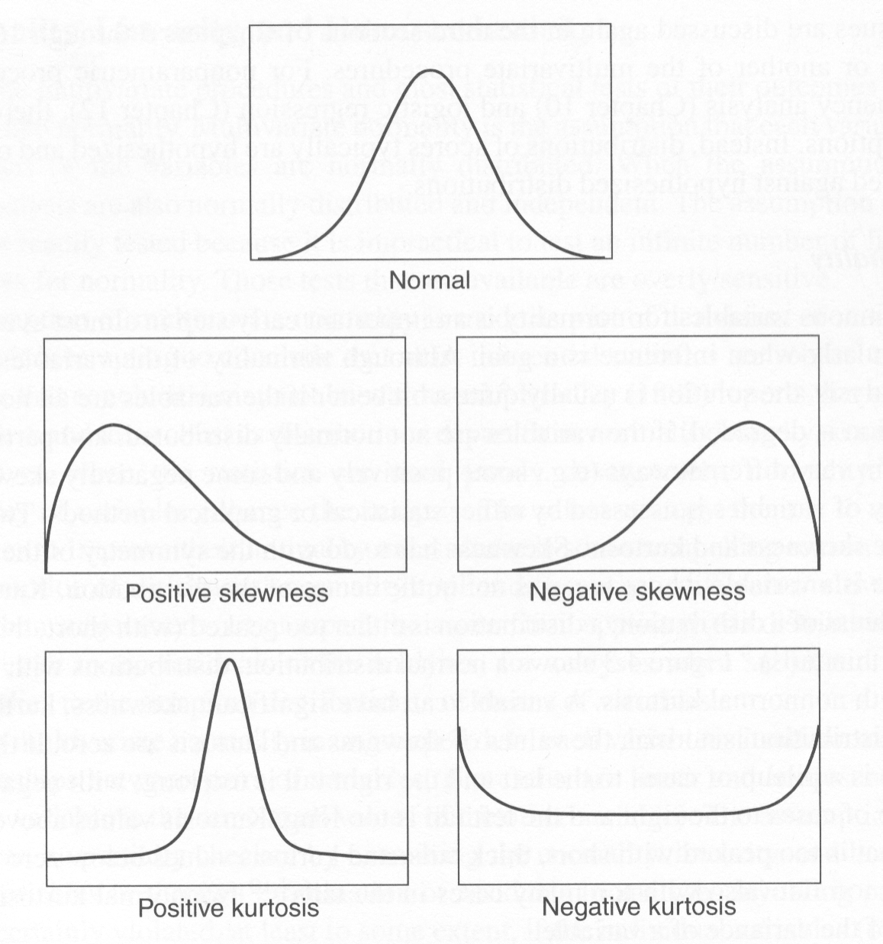
Skewness and Kurtosis

Slide 8
Outliers – “the data that should not be”
A data point or points that do not belong in your data set
Often viewed graphically as a point that sits outside of the distribution
Potentially detrimental because may have undo effects on the estimated statistics

Slide 9
Outliers
Univariate (example: brains in arc)
Should always check that data is coded correctly
Two ways of looking at it
a data point represents an outlier if it is disconnected from the rest of the distribution
Data is an outlier if it has a Z-score above 3.3
If there is a concern – run data with and without to see if it has any influence on the data

Slide 10
Outliers
Leverage – distance from other points
Discrepancy – degree to which point follows pattern of other points
Influence –change in the regression equation (Bs)
Calculated as a combination of Leverage and Discrepancy

Slide 11
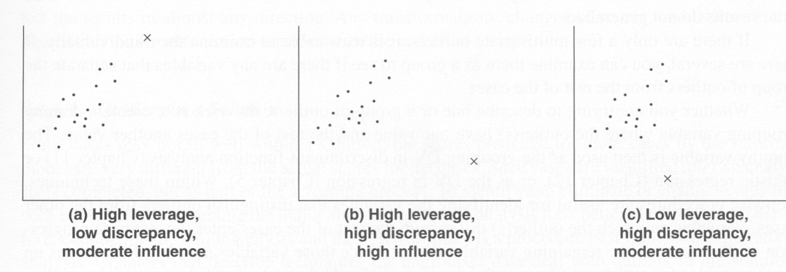
Outliers

Slide 12
Dealing w/ univariate outliers
Once you find outliers
Look into the case to see if there are indicators that the case is not part of your intended sample
If this is true delete the case
Reduce influence of outlier
Move value inward toward the rest of the distribution, while still leaving it extreme (controversial yet arguable approach)

Slide 13
Multivariate Outliers
Subject score may not be an outlier on any single variable; but on a combination of variables the subject is an outlier
“Being a teenager is normal, making $50,000 a year is normal, but a teenager making $50,000 a year is a multivariate outlier”.

Slide 14
Multivariate Outliers
Mahalanobis distance – measure of deviance from the centroid
(centroid = center of multivariate distribution created by the means of all the variables)
Mahalanobis distances (SPSS output) is χ² distributed
Critical Value (CV) → χ²(df = # variables; α = .001),
MD > CV = multivariate outlier
If Multivariate outliers found, not much to do except delete/de-select the case

Slide 15
Linearity – a limiting yet flexible assumption
Relationships among variables are linear in nature;
Assumption in most analyses
Example: resptran in arc

Slide 16
Homoscedasticity
For grouped data - synonymous with homogeneity of variance
For ungrouped data – variability for one variable is the same at all levels of another variable (no variance interaction)
A violation is called heteroscedasticity
Example: geese in arc

Slide 17
Multicollinearity/Singularity
If correlations between two variables are excessive (e.g. .95) then this represents multicollinearity
If correlation is 1 then you have singularity
Often Multicollinearity/Singularity occurs in data because one variable is a near duplicate of another (e.g. variables used plus a composite of the variables)

Slide 18
Transformations
Forcing that square peg in a round hole

Slide 19
Transformations
Tweaking your data to fit your assumptions
Allows for the correction of non-normality caused by skewness, kurtosis, or other problems (lack of linearity)
Shouldn’t be done if values represent meaningful scale
Square root – moderate violations, LOG₁₀ – more severe, and inverse - severe violation

Slide 20
Transformations
For positively skewed data
square root and log keep data in the original order but bring in the spread
inverse flips the order of the data
For negatively skewed data the reverse is true

Slide 21
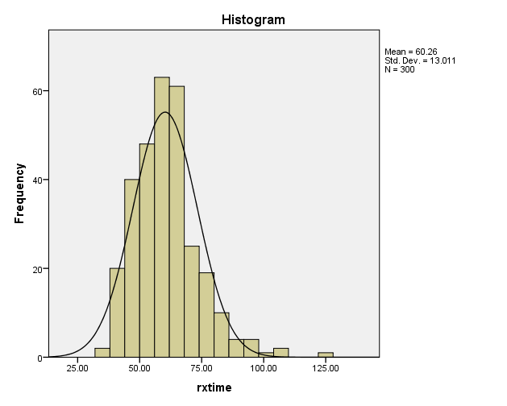
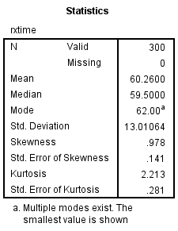
Example: Original Data

Slide 22
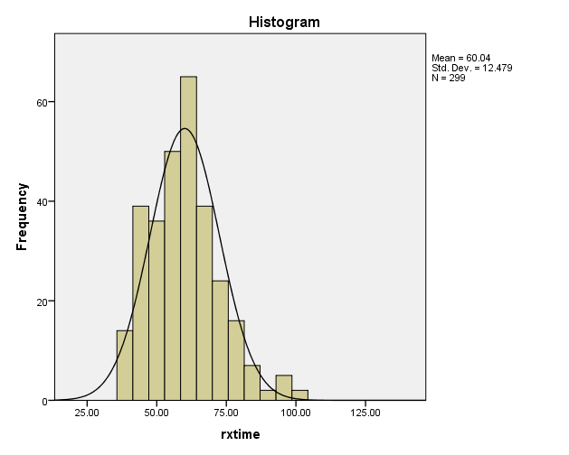

Example: Original Data without outlier

Slide 23
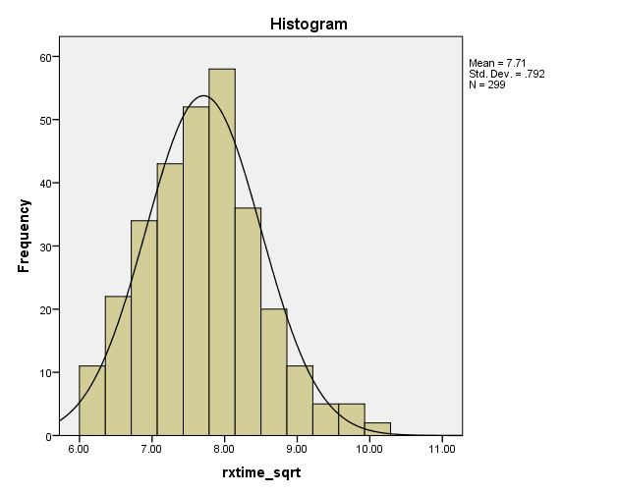
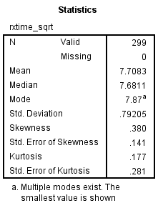
Example: Square root Transform

Slide 24
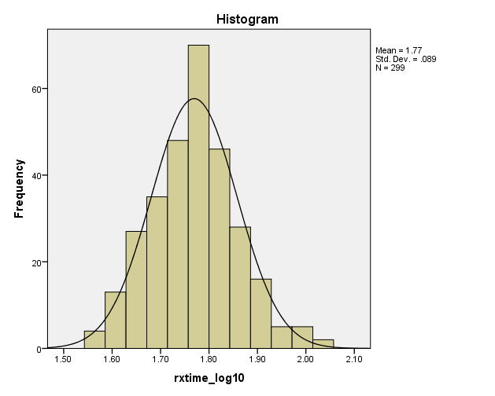
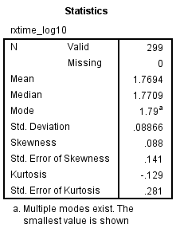
Example: LOG₁₀ Transform

Slide 25
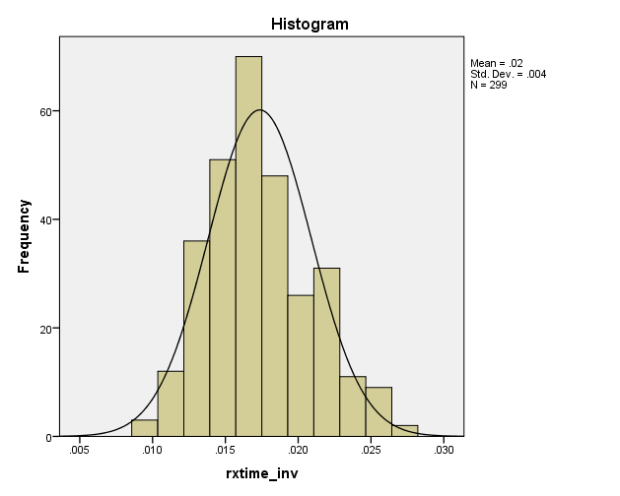
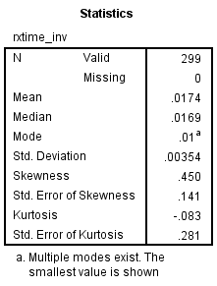
Example: Inverse Transform

Slide 26
Dealing with missing data
Staving off mortality with the magic of math

Slide 27
Missing Data – “data that should have been”
The default in many programs (e.g. SPSS) is to do a complete cases analysis (aka: listwise deletion)
Simple and easy
Creates concerns (e.g. percent of missing, pattern of missing) because doing complete cases analysis assumes the data are missing at random
Limits generalizability

Slide 28
Complete Cases Analysis
Only this case is used

Slide 29
Missing Completely at Random
MCAR – means that the patterns of missing on any one variable is not related to any other variable.
Example of non-MCAR: Measures of IQ and Income – subjects below a certain level of IQ (e.g. cutoff for intellectual disability) may not have any income because they are under guardian care, so they leave the income variable blank

Slide 30
Missing Value Correlation Matrix
Create a correlation matrix using complete cases for each pair of variables
Uses most data possible per pair
But each is based on different N
“Delete cases pairwise” in SPSS

Slide 31
Dealing with Missing Data
Imputation (replacing missing data)
Variable Mean insert
Doesn’t effect the mean estimation be restricts the variance
Group mean insert
Works for grouped data; similar issues with variable mean
Regression
Predicting a subject’s missing value from other variables
Variables used to predict should not be part of proposed model
Could be used iteratively

Slide 32
Dealing with Missing Data
Imputation (replacing missing data)
Estimation Maximization (EM) algorithm – this is a maximum likelihood iterative estimation method.
Multiple Imputation – name given to a family of processes that typically use multiple estimation methods, distributional constraints and built-in error estimation.
This is nice because it also gives you a standard error estimate for each imputation

